Slide 1

IMDB Movie Analysis
Project Description:-
The purpose of this research is to extensively investigate the IMDB movie dataset. Our analysis will focus on numerous critical variables, including genres, runtime, language, directors, and budget. By analysing these variables, we want to better understand how they impact IMDB ratings and film financial performance.
By- Mainak Mukherjee
Email- subha.mainak@gmail.com

Slide 2
-: Approach :-
To achieve the project goals, we used a clear method:
Data Preparation: We started by downloading the project's dataset, which includes information on movie titles, genres, durations, languages, directors, budgets, earnings, and IMDB scores. Then we cleaned the data and got it ready for analysis.
Data Analysis: We used Excel from basics to advanced level to analyze the data and answer the project's questions. This involved manipulating the data to find relevant information, calculating statistics, and visualizing the relationships between different variables.
Report Generation: We created a detailed report based on our analysis, which includes insights, visualizations, and statistical summaries.

Slide 3
-: Tech-Stack Used :-
For this project, the following tools were utilized:
MS Excel 2021:
Used for data analysis.
Excel's built-in functions, formulas and tools were crucial for performing calculations.
Generated visualizations to illustrate data trends and patterns.
Summarized the results effectively.
MS PowerPoint 2021:
Created a presentation to showcase project insights.
Ensured the information was presented in a clear and visually appealing format.
Google Drive:
Saved the final report for easy access.
Shared the report with others to facilitate collaboration and review.

Slide 4
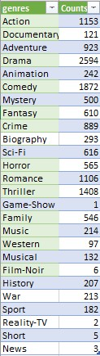
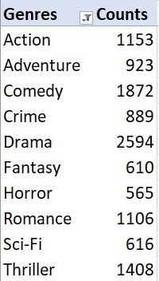
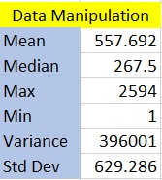
Task 1 :- Movie Genre Analysis
All Movie genres and their movie counts.
Top 10 Movie genres and their movie counts.
Statistics to understand the impact of genre on movie ratings.

Slide 5
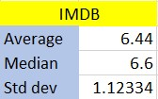
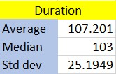
Task 2:- Distribution of movie durations and its impact on the IMDB score.
Rating stats
Duration stats
Rating & duration distribution using Scatter Plot

Slide 6
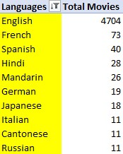
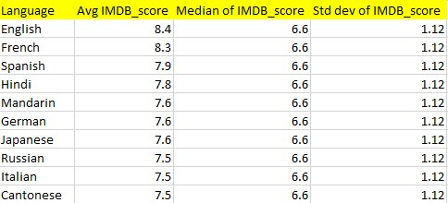
Task 3:- Distribution of top 10 movies based on their language.
Most common languages used in movies
Their impact on the IMDB score using descriptive statistics.

Slide 7
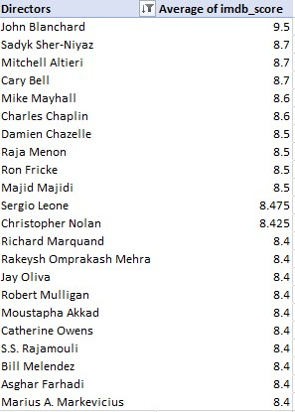
Task 4:- Director Analysis: Influence of directors on movie ratings.
Top directors based on their average IMDB score

Slide 8
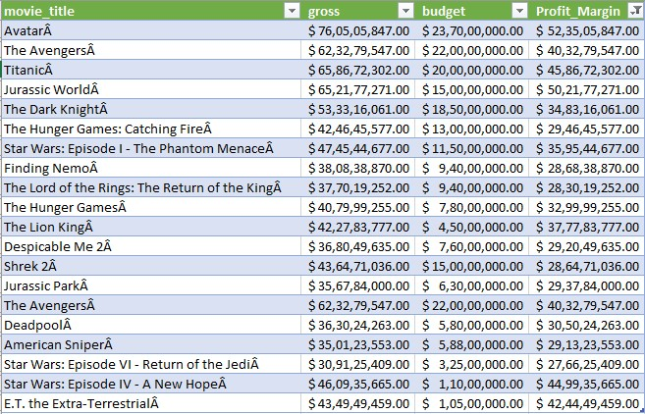


Task 5:- Budget Analysis: Explore the relationship between movie budgets and their financial success.
Top 20 movies with the highest profit margin.
Most profitable movie- ‘Avatar’ [1st]
Correlation coefficient between movie budgets and gross earnings

Slide 9
-: Insights Summary :-
Movie Genre Analysis:
Identified that Action, Adventure, Comedy, Crime, Drama, Fantasy, Horror, Romance, Science-Fiction and Thriller as the most common genres.
Analyzed their impact on IMDB scores, with no significant genre showing a clear advantage in ratings.
Movie Duration Analysis:
Movie durations ranged widely, from short films to epics.
Found a weak correlation between movie duration and IMDB scores, suggesting that length alone doesn't significantly affect ratings.
Slight indication that movies over 250 minutes may score between 6 and 8.5 on IMDB, with a trend suggesting longer movies might slightly improve scores.
Language Analysis:
English was the dominant language, followed by French, Spanish, Hindi, Mandarin, German, Japanese, Italian, Cantonese, and Russian.
Movies in non-English languages generally had slightly lower IMDB scores, hinting at possible audience biases.
Director Analysis:
Highlighted top directors with high average IMDB scores, including John Blanchard, Sadyk Sher-Niyaz, Mitchell Altieri, Cary Bell, Mike Mayhall, Charles Chaplin, Damien Chazelle, Raja Menon, Ron Fricke, Majid Majidi, Sergio Leone, and Christopher Nolan.
These directors consistently produced high-rated movies, indicating their strong influence on audience perception.
Budget and Profit Analysis:
Examined the correlation between movie budgets and gross earnings, a correlation of 0.1021795 indicates a very weak positive relationship between movie budgets and gross earnings. In practical terms, this suggests that there is a slight tendency for higher-budget movies to earn more.
Movies with budgets over $200 million had a higher likelihood of achieving significant profit margins.

Slide 10
-: Project Conclusion :-
This project provided valuable insights into the factors influencing movie ratings and financial performance. By examining genres, durations, languages, directors, and budgets, we identified key trends and patterns that reveal audience preferences and industry dynamics. Our findings offer actionable recommendations for filmmakers, producers, and studios to enhance their production strategies and maximize audience appeal.
Original dataset:- https://drive.google.com/file/d/1JAwSmX1JLDumdMh7jVdi3Szpuuz4HI_g/view?usp=sharing
Cleaned datafile:- https://docs.google.com/spreadsheets/d/1vdqu33Ck9n_Efg_IBH0eKAGVpoZDkrsB/edit?usp=sharing&ouid=103027981944924775198&rtpof=true&sd=true
Loom Video Presentation:- https://www.loom.com/share/9dc12a9cf889447688abea7b5b011232?sid=4185c93c-27ac-4d7f-a355-a1dd670408c5
Thank You

